Slide 1
An Improved Public Unclonable Function Design for Xilinx FPGAs for Hardware Security Applications 1st M.A.Sc Seminar
Presenter: Siva Prashanth B
Supervisor: Dr. Mohammed A. S. Khalid
Dr. Mitra Mirhasanni
Date: , 2018
University of Windsor
Department of Electrical and Computer Engineering

Slide 2
Seminar Outline
Introduction
Problem Statement
Related Works
Research Goals and Strategy
Current Research Status
Summary
References

Slide 3
INTRODUCTION:
Physical Unclonable Functions (PUFs) are digital circuits that produce unique signature bits based on process variations that occur in manufacturing process in an Integrated Circuit(IC)
PUF’s eliminate the need to utilize expensive cryptographic algorithms for security. Instead we can use small part of the hardware as a security device
No need to store the secret keys in digital memory such as SRAM and EEPROM which could be vulnerable to many attacks

Slide 4
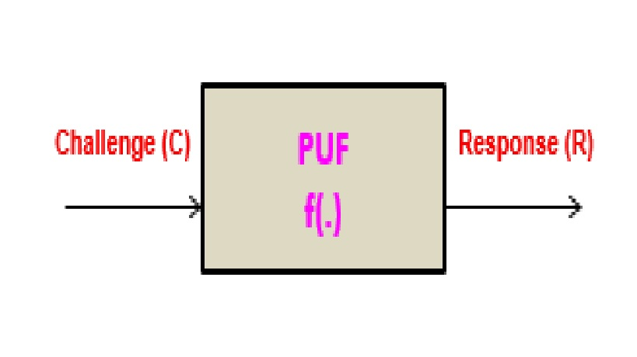
How does PUF work ??
A PUF is passed an input challenge C, and returns a response R
R = f (C), where f (.) describes the input/output relations of the PUF

Slide 5
Why PUFs are important ?
PUF hardware uses simple digital circuits that are easy to
fabricate or can use built in structures in Ics
Consumes less power and area than EEPROM/RAM based security solutions
Nonvolatile memory is more expensive to manufacture. EEPROMs require additional mask layers, and RAMs require an external always-on power source

Slide 6
Classification of PUF:
Weak PUF: Used For key storage. A weak PUF (also called as Physically Obfuscated PUF) has a very small range such that it can have collisions with one or other challenges that give the same response.
Strong PUF: Commonly used for authentication. Strong PUFs have a large domain and support a lot of Challenge Response Pairs (CRPs) that means they can be used effectively and securely.

Slide 7
Properties of PUF
Intra-Distance PUF Variation:
Its defined as the number for bits in a PUF response that change when the same challenge input is given to the PUF. Usually, this happens due to environmental variation and statistical noise
Inter-Distance PUF Variation:
Its defined as the number of bits in a PUF response that vary between different devices for the same challenges. This is due to differences in IC Fabrication. It’s the measure of the uniqueness

Slide 8
PROBLEM STATEMENT:
Creating an improved PUF model of an Anderson’s design for
Xilinx Virtex FPGA [2].
Measuring the anderson’s PUF intra-distance variation of 90 bits.
we see an error of around 30% [2].
IP Protection by a low cost method for the Xilinx FPGAs

Slide 9
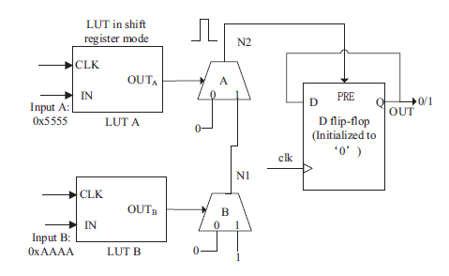
RELATED WORKS:
Anderson’s PUF:
a PUF circuit was designed using 2 LUTs, 2 carry chains and one F/F of the underlying architecture of 65nmVirtex 5 Xilinx FPGA.[5]
The PUF circuit consumes very little area (i.e) 2 slices so we can have less hardware overhead.

Slide 10
How the PUF works ?
clk LUTs A,B in shift register mode
OUT
clk
A
IN
…1010
0101…
OUT
B clk
…0101
IN
1010…

Slide 11
How the PUF works ?
clk
LUTs A,B in shift register mode
N2
OUT
clk
MUXA
0 1
A
…1010
0101… ^{IN}
logic-0
Carry chain multiplexers
N1
OUT
clk
MUXB
B
1010… ^{IN}
…0101
0
1
logic-0 logic-1

Slide 12
How the PUF works ?
clk
LUTs A,B in shift register mode
N2
OUT
clk
MUXA
0 1
A
…1010
Initially: N2: logic-0 N1: logic-1
0101… ^{IN}
logic-0
N1
OUT
clk
MUXB
B
1010… ^{IN}
…0101
0
1
logic-0 logic-1

Slide 13
How the PUF works ?
clk
LUTs A,B in shift register mode
N2
MUXA
0 1
At clock edge: MUX selects toggle
OUT
clk
A
…1010
0101… ^{IN}
logic-0
N1
Faster?
OUT
clk
MUXB
B
1010… ^{IN}
…0101
0
1
logic-0 logic-1

Slide 14
How the PUF works ?
clk Glitch!
N2
Faster?
MUXA changes before N1 →
pulse on N2.
OUT
clk
MUXA
0 1
A
…1010
0101… ^{IN}
logic-0
N1
OUT
clk
MUXB
B
1010… ^{IN}
…0101
0
1
logic-0 logic-1

Slide 15
How the PUF works ?
clk
N2
D PRE Q
PUF bit
OUT
clk
MUXA
0 1
A
…1010
0101… ^{IN}
Flip-flip initialized to logic-0
logic-0
N1
OUT
clk
MUXB
B
1010… ^{IN}
…0101
0
1
logic-0 logic-1

Slide 16
RESEARCH GOALS AND STRATEGY
Re-Designing the Anderson PUF to avoid intra PUF variation
Efficient Model of the PUF Design changing the glitch value to 0 instead of 1 which leads to a robust design
Designing an FSM based Hardware Trojan with the proposed PUF

Slide 17
Re-Design of Anderson PUF
Previous published research analysis [2] pointed out the design shortcomings that glitches of short duration are not enough to trigger the flip flop
To overcome this Constant glitch problem, we have two solutions:
1) Measurement after a specific delay.
2) A One-shot approach.

Slide 18
Measurement after specific delay
To latch the PUF output at a single point of time.
PUF response at a later point in time so that response is close to being uniformly distributed without the need for key extraction.
The results relate to sampling the PUF after .5 sec after power on, then using the response at a variety of times thereafter.

Slide 19
One-shot approach:
We control the glitch width transitions between LUT0 and LUT1 by increasing it so the probability that a glitch occurs at a Clear input of flipflop is also increased.
This can be realised by adding an additional carry chain between the two LUT’s.

Slide 20
Modification of the Anderson’s PUF Design by changing the glitch value from ‘1’ to ‘0’
clk
N2
D CLR Q
PUF bit
OUT
clk
MUXA
0 1
A
…1010
0101… ^{IN}
Flip-flip initialized to logic-1
logic-1
N1
OUT
clk
MUXB
B
1010… ^{IN}
…0101
0
1
logic-1 logic-0

Slide 21
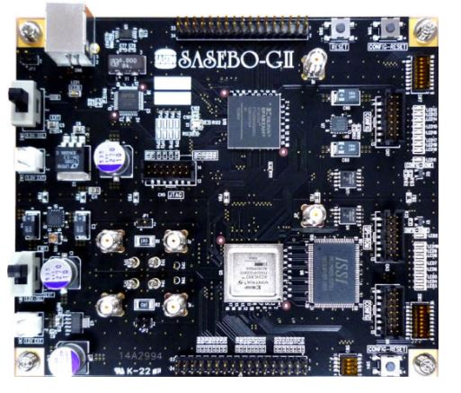

Experimental Setup

Slide 22
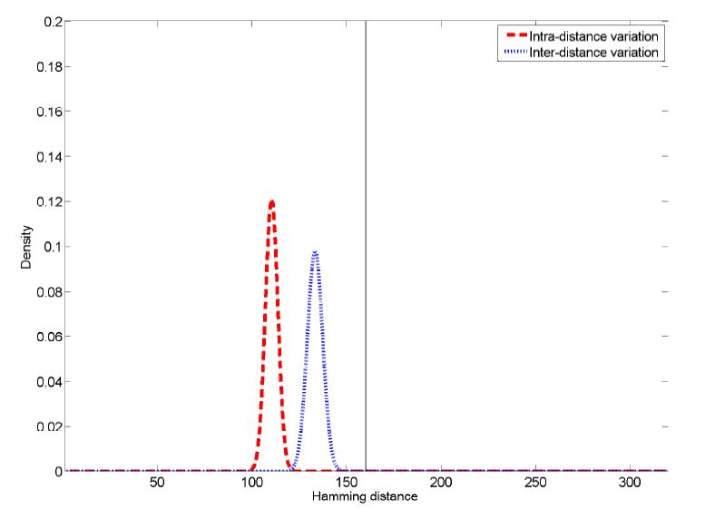
Experimental Results
Fig 1 : Intra- and inter-distance metrics for a 320-bit Anderson PUF.

Slide 23
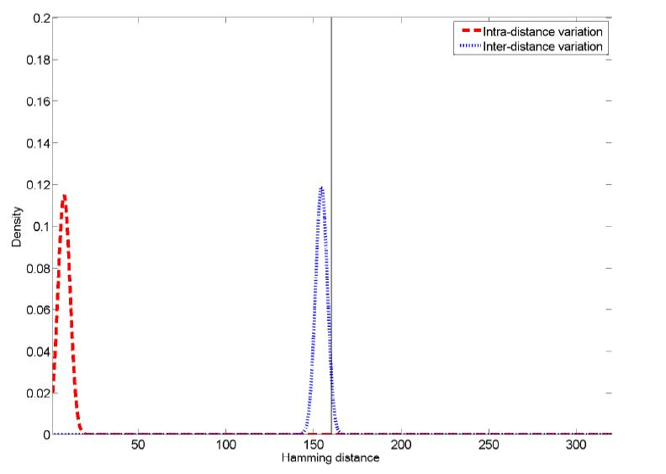
Experimental Results
Fig 2 : Intra- and inter-distance metrics for a 320-bit Anderson PUF with first approach

Slide 24
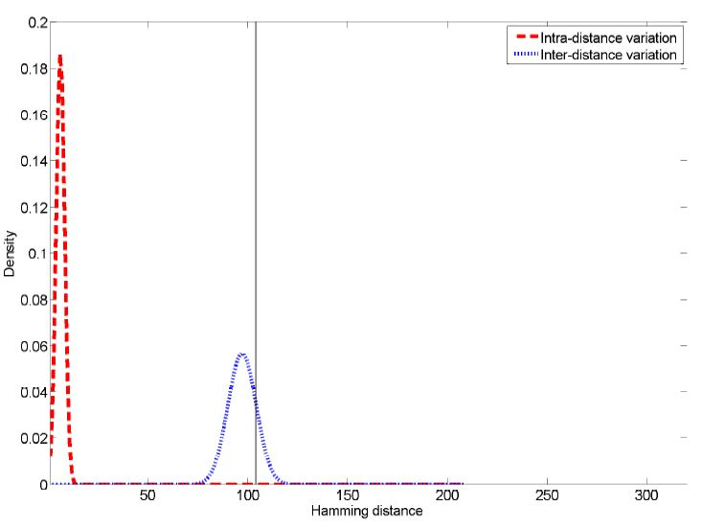
Experimental Results
Fig 3 : Intra- and inter-distance metrics for a 320-bit Anderson PUF with second approach

Slide 25
Hardware Trojans for Secure licensing applications
IP Providers sell VHDL and Verilog IP cores to many unknown customers
Many industries try to trace the IP and make their own pirated designs
We can use Hardware Trojan (HT) to stop IP piracy
HT is a malicious modification of the digital circuitry of an integrated circuit. HT is completely characterized by its physical representation and its behaviour
We use FSM based securing algorithm for protecting the IP cores [6]
This FSM needs to be hidden from attackers. Obfuscation technique will be used during this research based on re-simulating the FSM of the IP core with the added FSM to gather a flattened netlist.

Slide 26
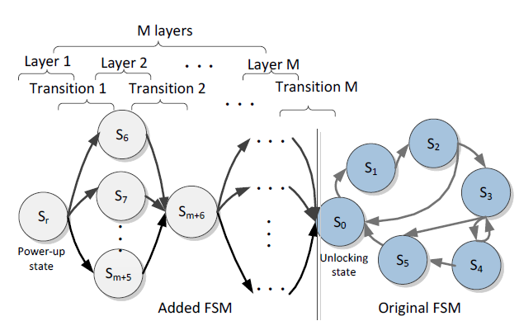
The binding FSM structure. The original states are shown in dark and the added states are shown in white on the STG of the added FSM. [3]
FSM Model of a Trojan

Slide 27
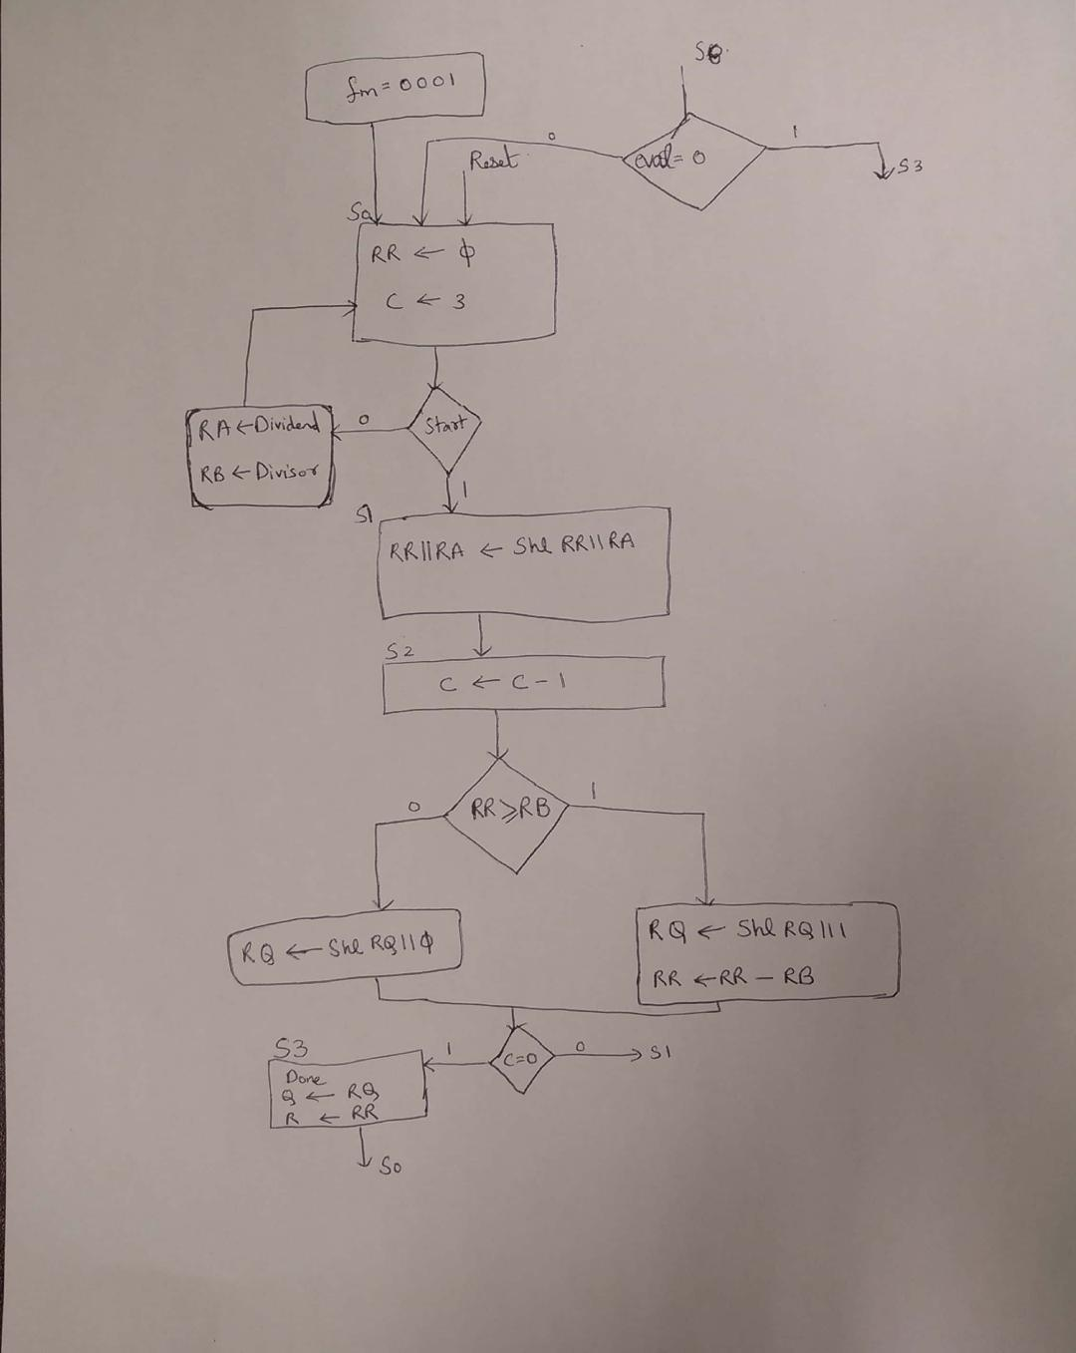
ASM for a 4 Bit Division with FSM based Trojan

Slide 28
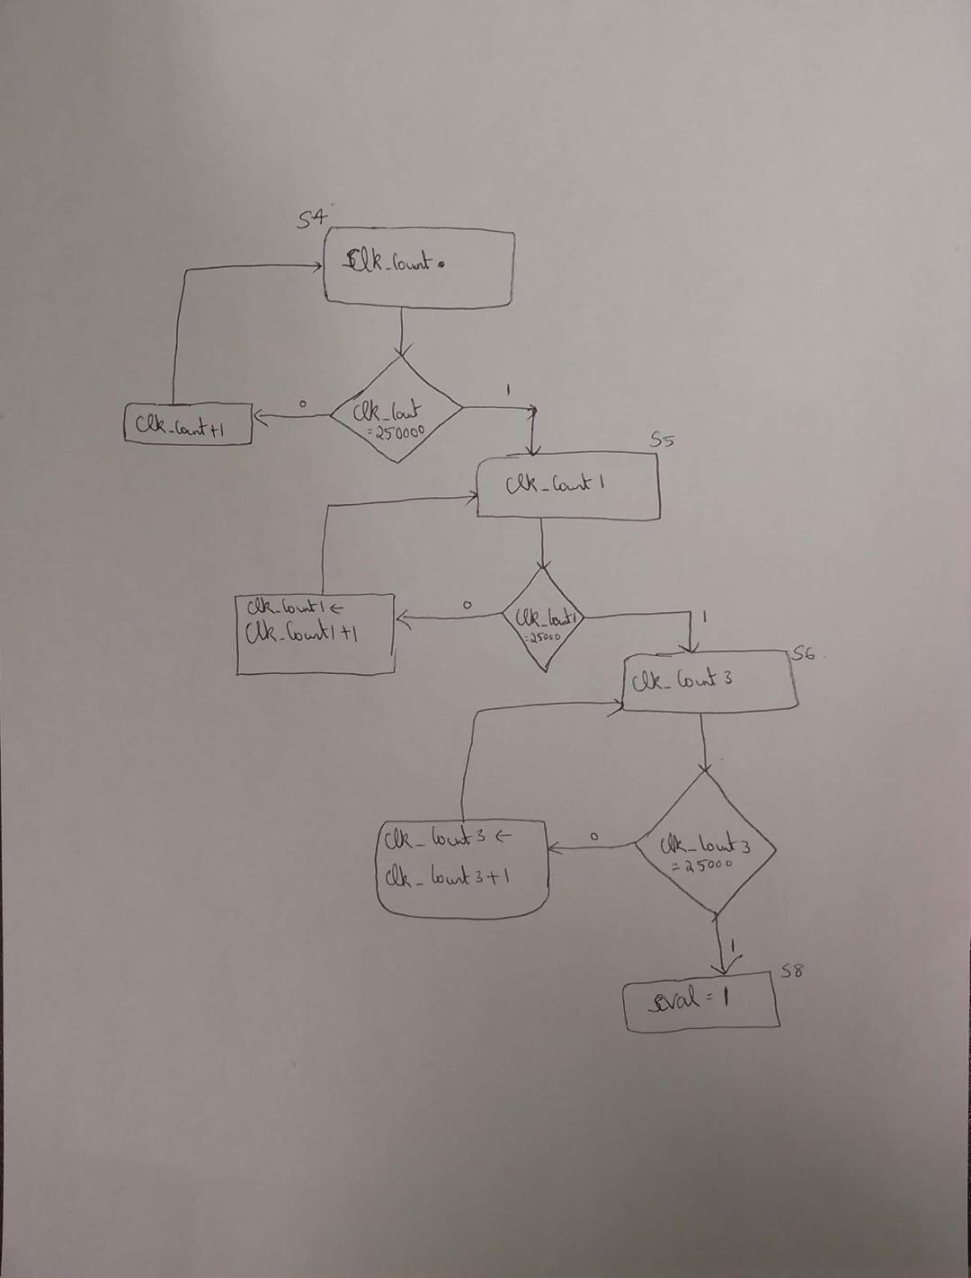
ASM for a 4 Bit Division with FSM based Trojan

Slide 29
Expected Implementation and Results:
The proposed PUF and the binding FSM IP protection method will be implemented on Xilinx FPGA Tools.
ISE is used for Virtex-5 and lower devices and Vivado is used for recent devices higher than Virtex-7.
To evaluate the effectiveness of the proposed binding method using the Md(Obfuscated Metric)[6].
The area, timing and power overhead will be studied on the benchmark circuits.

Slide 30
CURRENT RESEARCH STATUS
Obtained results for the proposed PUF with a change in glitch value [7].
Designed FSM based model for a simple multiplier IP.
Results for Re-Design of the Proposed PUF has been shown.

Slide 31
SUMMARY:
Thus PUFs can act as a good low cost Hardware Protection for FPGA Devices
They can be used for Anti - Counterfeiting, Anti-Cloning, Trusted Storage, Secure Payments, Machine to Machine and Device to Cloud Authentication
It can be designed to make it as an evaluation version and later can be made in such a way that the users will pay for it when they are using the IP

Slide 32
FUTURE RECOMMENDATIONS:
Investigation of whether the saturation effect itself is an intrinsic property of an FPGA device
Analysing protection and detection techniques on ASIC’s instead of FPGAs
Comparing the security strength of the proposed designs

Slide 33
REFERENCES:
[1] J.H Anderson. A PUF design for secure FPGA-based embedded systems. In ASP-DAC, pages 1-6, 2010.
[2] P. Grabher, D. Page and M. Wojcik. On the (re) design of an FPGA-based PUF, International Association for Cryptologic Research, 2013.
[3] A. Al-Anwar, Y. Alkabani, M. W. El-Kharashi and H. Bedour, "Hardware Trojan detection methodology for FPGA," 2013 IEEE Pacific Rim Conference on Communications, Computers and Signal Processing (PACRIM), Victoria, BC, 2013, pp. 177-182.
[4] M. Rostami, F. Koushanfar and R. Karri, "A Primer on Hardware Security: Models, Methods, and Metrics," in Proceedings of the IEEE, vol. 102, no. 8, pp. 1283-1295, Aug. 2014.
[5] Virtex-5 FPGA Data Sheet, Xilinx, Inc., San Jose, CA, 2007.
[6] M. Majzoobi, F. Koushanfar, and M. Potkonjak, “Techniques for design and implementation of secure reconfigurable PUFs,”ACM Trans. on Reconfigurable Technology and Systems, vol. 2,no. 1, pp. 1–33, 2009.

Slide 34
REFERENCES:
[7] Jeroen Leijten, Jef van Meerbergen and Jochen Jess,“Analysis and Reduction of Glitches in Synchronous Networks”, Department of Electrical Engineering, Eindhoven University of Technology, The Netherlands.
[8] R. Brodersen, A. Chandrakasan and S. Sheng, “Low-Power Signal Processing Systems”, 5th IEEE Workshop on VLSI Signal Processing, California, USA, October 1992.
[9] C. Herder, M. D. Yu, F. Koushanfar and S. Devadas, "Physical Unclonable Functions and Applications: A Tutorial," in Proceedings of the IEEE, vol. 102, no. 8, pp. 1126-1141, Aug. 2014.

Slide 35

QUESTIONS

Slide 36
THANK YOU

